Slide 1
Comparison between New York City and Toronto

Slide 2
Introduction
It was interesting to see how the different neighborhoods to world’s biggest cities could be similar or dissimilar
The neighborhoods of two important cities in the world—New York City (NYC) and Toronto—were compared to understand the similarities and differences between the two cities neighborhoods.
The clustering technique was used and was based on the types (categories) of venues in the neighborhoods. Each of the resulting clusters had neighborhoods that contain similar distribution of venues.

Slide 3
Data Acquisition and Preparation
Since clustering was based on the categories of venues in the neighborhoods, we needed the data that specifies the venues in the neighborhoods and their categories.
To acquire data on venues and their categories, Foursquare API was used.
The result of the data-acquisition-and-preparation stage was two tables (dataframes) that specified the neighborhoods and the venues of each of NYC and Toronto

Slide 4
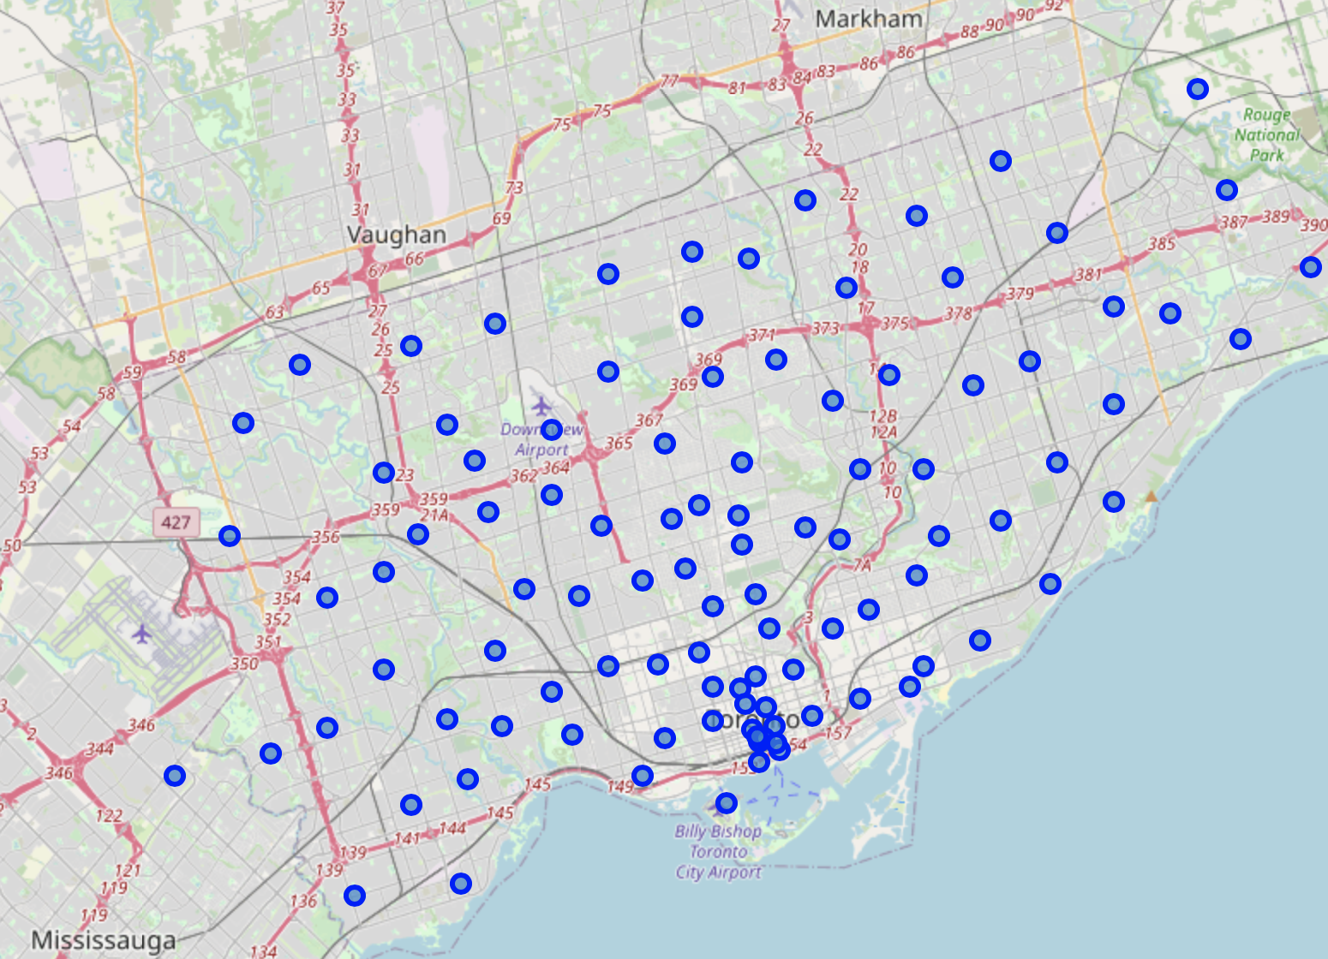
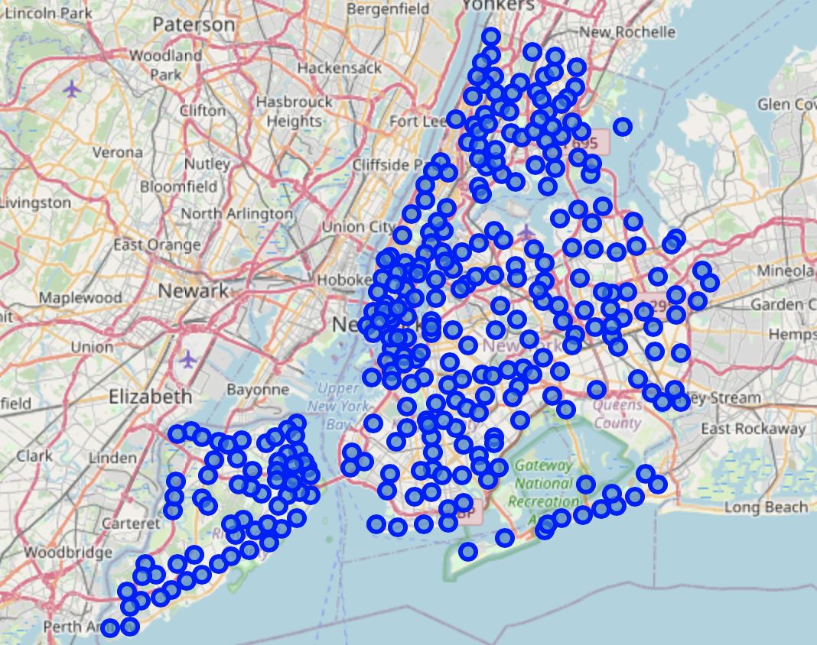
Toronto
New York City

Slide 5
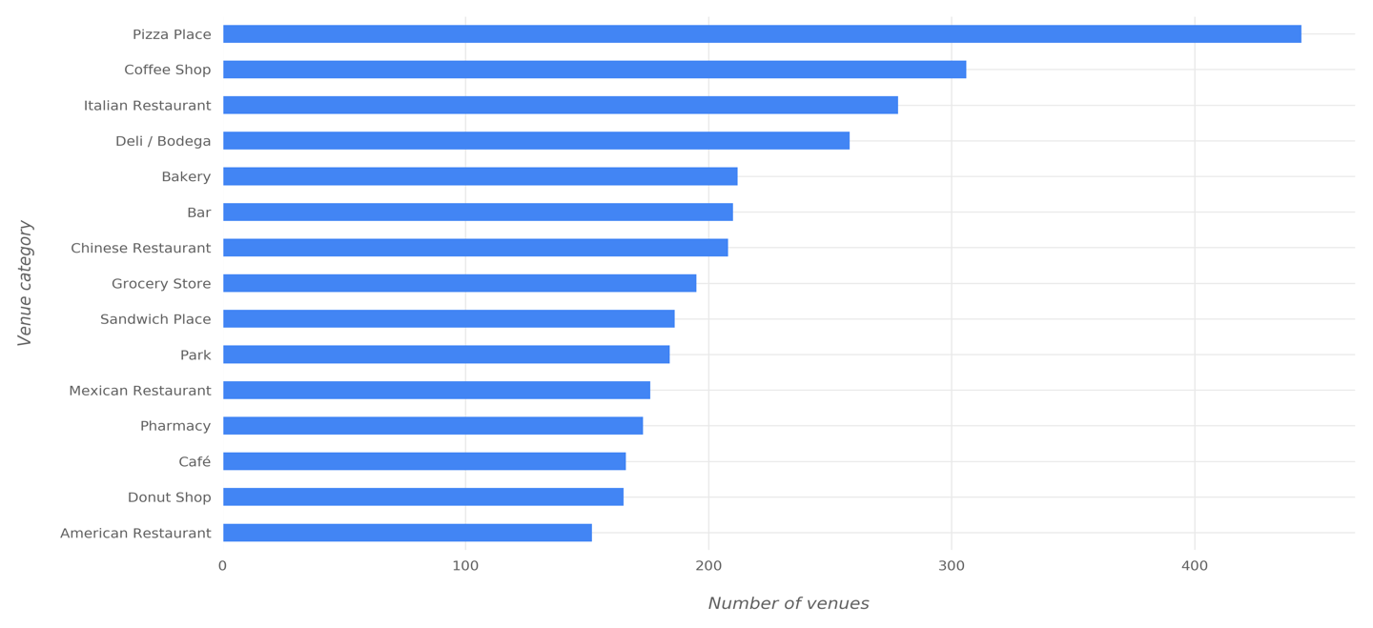
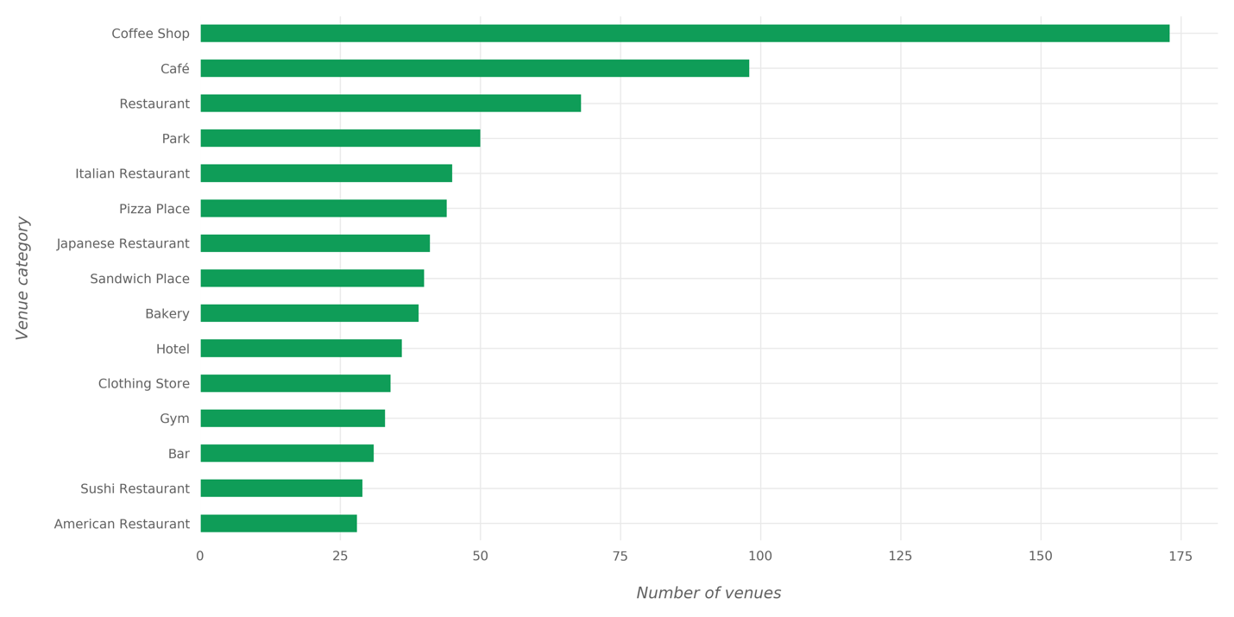
Exploring Neighborhoods
New York City : Below figure shows a bar plot of the most common venues in NYC.
Toronto City: Below figure shows a bar plot of the most common venues in Toronto.

Slide 6
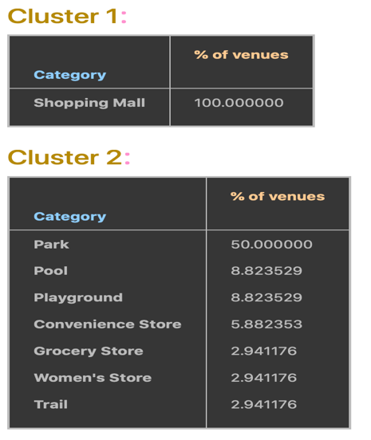
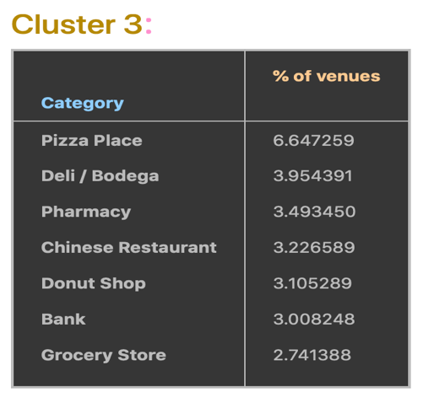
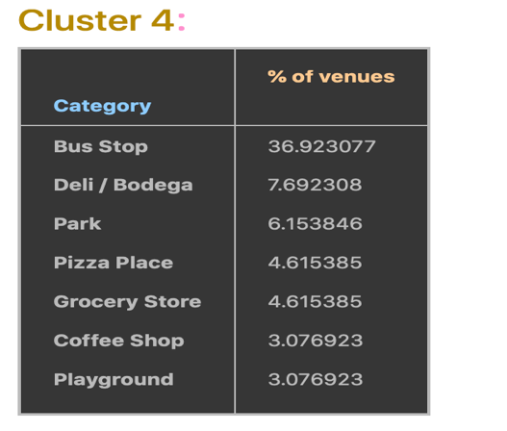
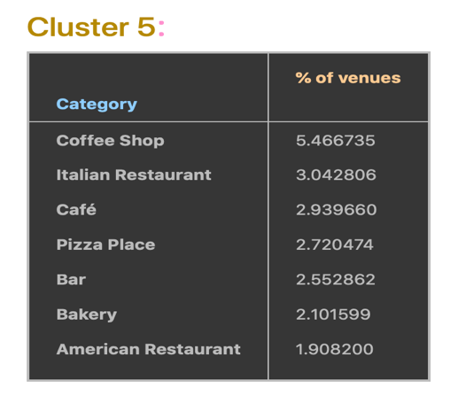
Clustering
The clustering algorithm grouped neighborhoods of NYC and Toronto in 5 clusters based on the similarity between their venues. Now, these clusters will be investigated to see the most common categories in each of them. Below figures show the most common 10 venue categories in each cluster

Slide 7
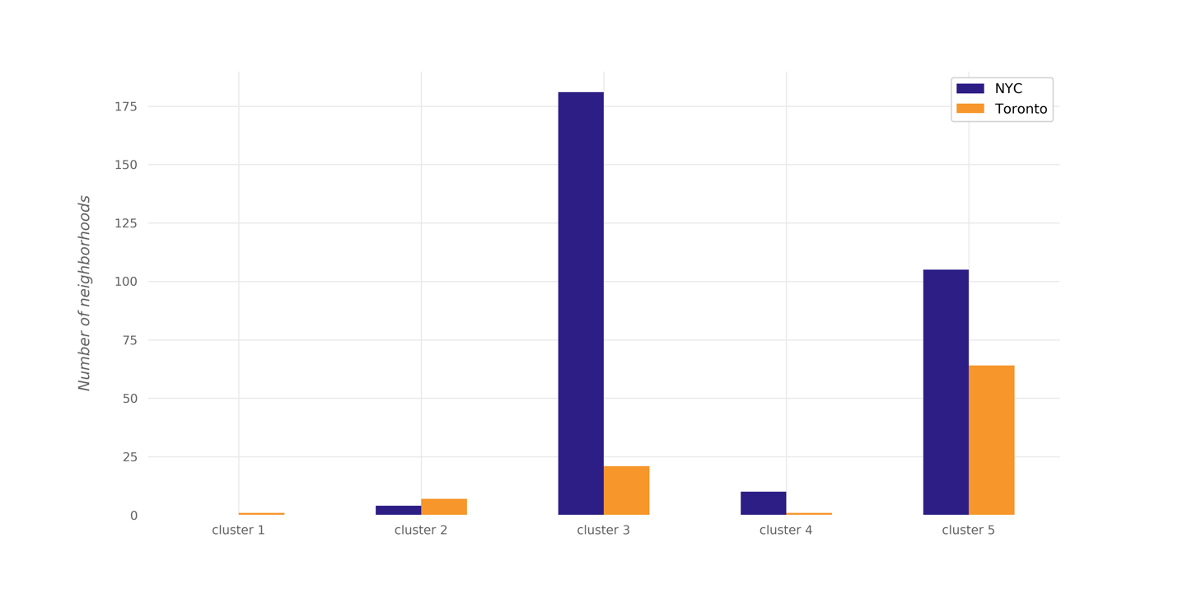
Analysis
The plot below shows the number of NYC neighborhoods and the number of Toronto neighborhoods in each cluster.

Slide 8
Conclusion
The results showed that there are venue categories that are more common in some cluster than the others; the most common venue categories differ from one cluster to the other.
If a deeper analysis—taking more aspects into account—is performed, it might result in discovering different style in each cluster based on the most common categories in the cluster.

